Slide 1

WEB DEVELOPMENT PART 1
LESSON 1
CFGDEGREE → FULL-STACK STREAM

Slide 2

AGENDA
01 Introduction to HTML
02 Tags & Implementation
03 Stylising with CSS
04 Selectors

Slide 3

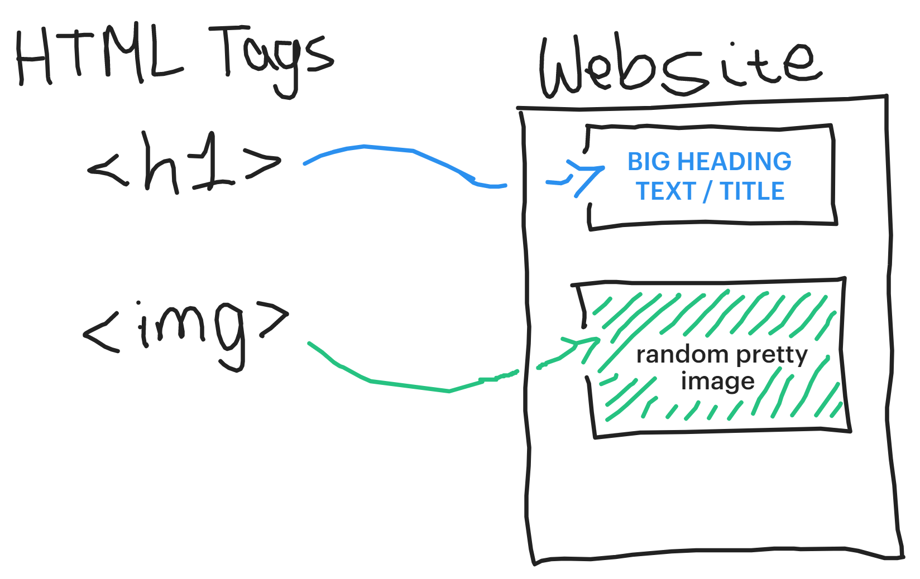
What is HTML?
Hyper-text markup what now?
# EXAMPLE
HyperText Markup Language is how websites are structured - its code effectively lets us create the ‘skeleton’ of the website
Through its code (HTML tags), we can add images, text, headings and other elements
These elements are basic - they have no style, no specified font, color, etc (that’s a job for later). HTML however lets us create the foundation before we style it further

Slide 4
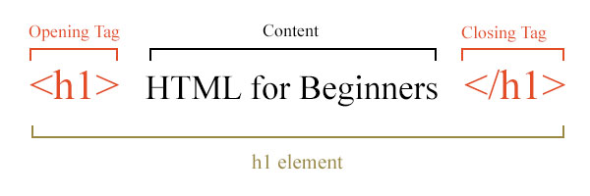
HTML Tags
What do they look like?
Each HTML Tag / element normally has 3 parts:
Opening Tag (denotes what tag / block we’re adding)
Content (Whatever we want to add - could be some specific text)
Closing Tag (Denotes that we’re done, there’s no more content to consider or display)
So for the example, it translates (human-wise) to:
<h1> → Create a HTML Tag that’s H1 (Heading 1 - biggest heading available compared to H2 or H3)
{Content} → Add this text inside it (“HTML for Beginners”)
</h1> → Stop doing any H1 stuff / we’re all done now
# EXAMPLE FORMAT

Slide 5
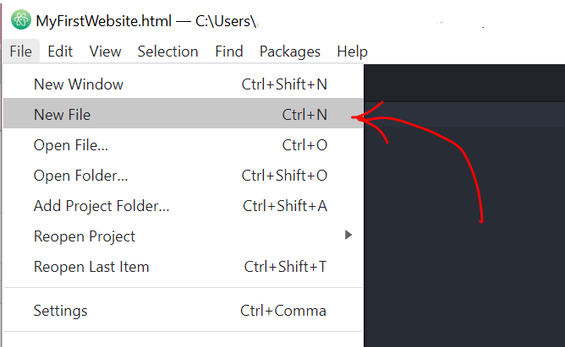
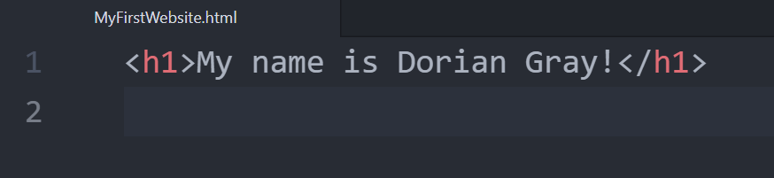
# EXAMPLE
HTML tag exercise
Try your own!
Open Atom, Visual Basic Studio or any other appropriate IDE (PyCharm isn’t suitable for this unfortunately!).
Create a new file and call it something similar to:
“MyFirstWebsite.html”
(The .html at the end is particularly important!)
Write in your own html tag! Use the <h1> tag that we covered before; for content, use your name!
Open your new file using a browser afterwards. What do you see? What happens if you change the text? Or remove parts of the tag?
Screenshot 1
Screenshot 2

Slide 6

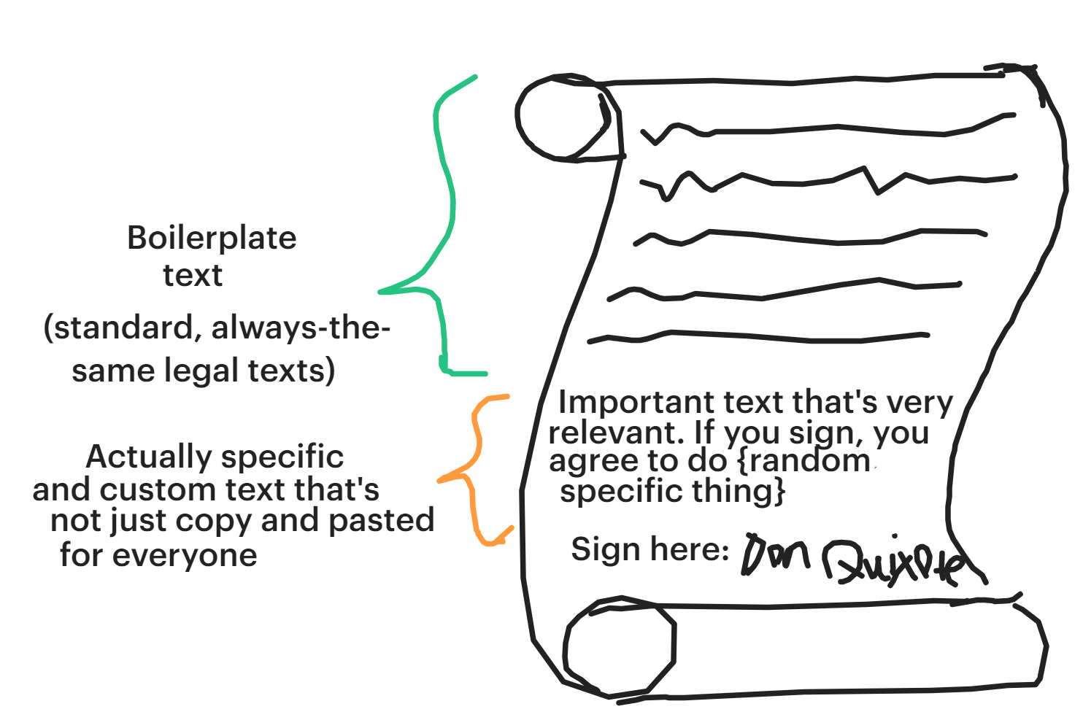
The new type of armor: Boilerplate
Medieval armor technology moves so fast!
Boilerplate is effectively text that’s re-used repeatedly with little to no change. Remember how T&C’s have dozens of pages, and most of it is always the same? That’s boilerplate!
We have the same idea in programming; some code we have to write because it’s mandatory and necessary, but it doesn’t change at all.
HTML Files all have boilerplate - this is a few lines of code that denote its HTML. As programmers, we just copy & paste it in usually and write the rest of the personalised, custom, actual HTML code later on ourselves!
# EXAMPLE

Slide 7
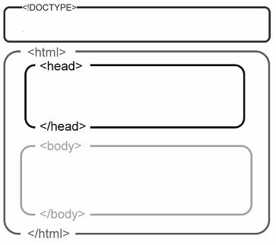



Boilerplate in HTML!
We’ll make a website out of that ‘MyFirstWebsite’
# EXAMPLE OF HTML BOILERPLATE
You’ll need to add the following to your file:
<!DOCTYPE html> → A flag for the browser - basically highlights that it’s a HTML file so that the browser knows that it should render HTML.
<html> </html> → Represents the ‘root’ of the website. The idea is that this is the ‘top’ element, and all others nested inside are its children / parts. This is ‘the HTML’, with all other elements comprising what it looks like.
<head> </head> → Make sure this is nested inside the ‘html’ tag! This part is for holding ‘metadata’ (data about data) (context regarding the website; what’s the title, what links to place inside, does it use any other files)
<body> </body> → Nest this inside ‘html’ too! This refers to the bulk of html blocks; it’s effectively a “all my content for this website is inside here!”
Notes:
Please walk students through this example! Effectively amend the MyFirstWebsite that you have yourself, and add boilerplate around it. Explain the importance and need for boilerplate, and just ensure that students have an understanding of how to add it to their own files / amend their own as necessary.

Slide 8
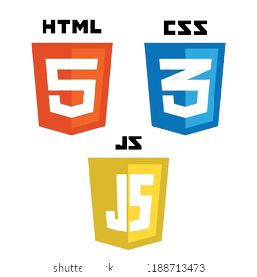
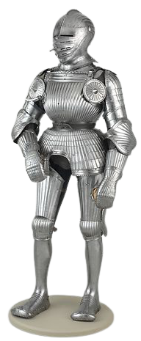
Exercise: Add boilerplate to your website!
Take 5 minutes; you’ll need the tags below, add them to your site!
# HTML BOILERPLATE EXAMPLE
Remember to use:
DOCTYPE
Head
HTML
Title
(Your site should have a title too, add one! Something like “MyFirstWebsite”)
Feel free to google it too (completely normal and encouraged in SWE!); find the tags you need and add them appropriately!
Notes:
After observing how you did it / added boilerplate, just give students a quick 5 minutes to add their own!

Slide 9
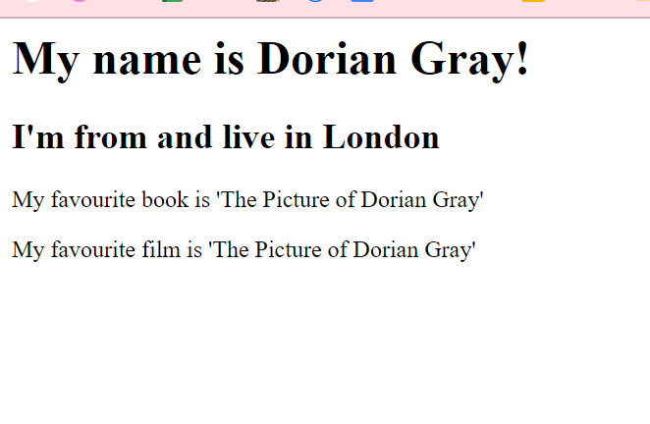
Exercise 2: Add more text!
Don’t write a book (yet), but at least add some more text!
Using the following tags….
<h1> (or h2, h3, …, h5, h6)
<p>
……add the following information to your website:
Your name
Which city you’re from in the world
Your favourite book
Your favourite film
Use a combination of tags: you must have at least one of headings + paragraph tags
Remember - you can google throughout! (Hint: Use Mozilla documentation, it’s incredibly thorough)
# EXAMPLE OUTPUT

Slide 10

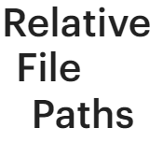


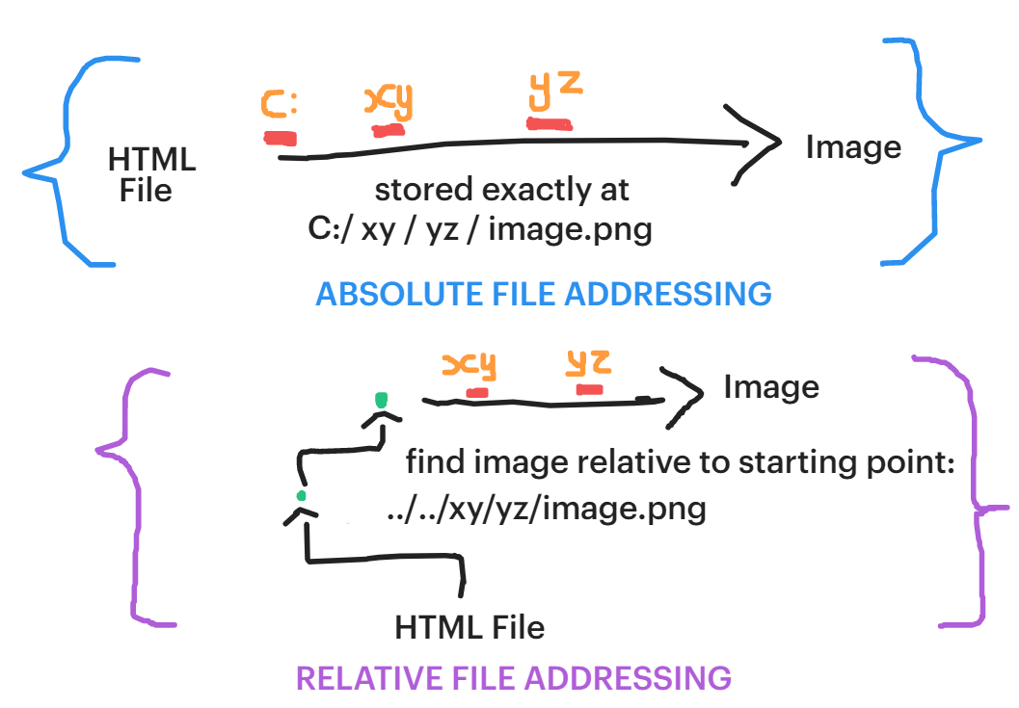
File addresses and relative paths
Before we going forward, let's discuss relativity relative paths
Files can often make references to other files surrounding them
For example, if I want to embed an image into my current HTML file, I can point my HTML file to where my image is located on my computer system
Two types you should note:
Absolute: If I want to find file x, whilst I’m in file y, I have to start from the very beginning (the top of the computer file hierarchy, the C: drive, the very very beginning) and branch from there
Relative: Here, we instead start from file y - we find file x relative to the position of file y (e.g. I’m on level 5, go up two levels to level 4 to find x!)
# EXAMPLE

Slide 11
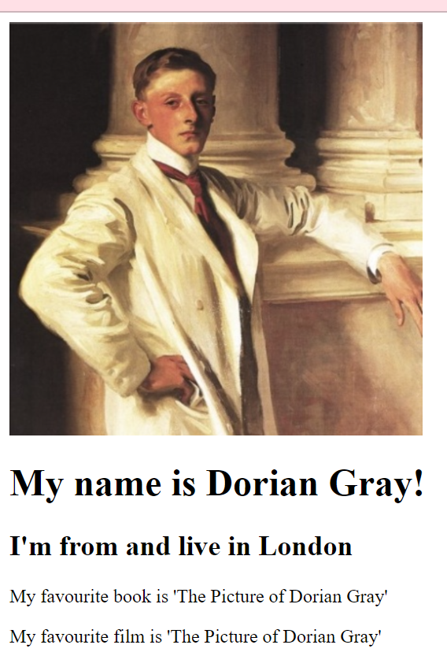

Exercise 3: Add a headshot!
# EXAMPLE OUTPUT
We’ll use the <img> (image) tag for this!
The <img> tag allows us to place a image within a website. Within this tag, we normally also have attributes that modify how <img> presents like:
src → Required. We point this attribute to be the file we want displayed e.g. “dorianGray.png”
alt → Optional. This holds a text description of the image that we write ourselves e.g. “cover of Dorian Gray”; very useful for accessibility.
width, height → Self-descriptive
For ~eight minutes (depending on your instructor's discretion), find the image tag online and write it in yourself. The point of this is to become self-sufficient / find tags yourself
Your instructor will then demo a solution afterwards

Slide 12

PART 2
CSS

Slide 13
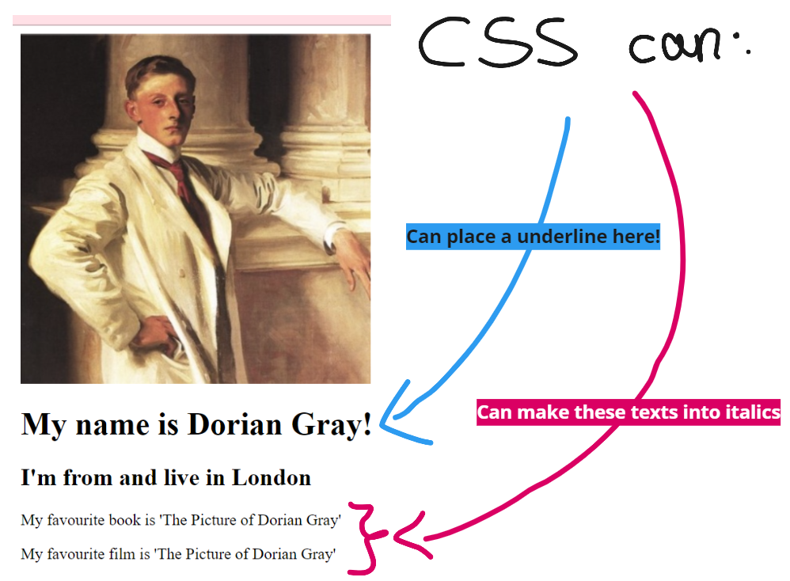
Introducing CSS
Finally, some style
# EXAMPLE
Cascading Style Sheet (CSS) is a stylesheet language - it describes how HTML should be displayed (to the browser).
For example, it can point to a specific element (e.g. the paragraph tag) and say that it should have bold text - from that point on, the <p> tag will be displayed as bold!
Consider HTML as the bland body you create (e.g. we should have two eyes!), whereas CSS is the attributes you set (e.g. those eyes should be the colour brown!)

Slide 14
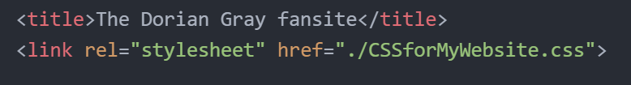
Part 1 Walkthrough: CSS How-to
Linking CSS to our own website!
# EXAMPLE
Create a new file, in the same location as your HTML one, called ‘CSSforMyWebsite.css’ (or something else, just make sure it ends with ‘.css’!)
CSS needs to be first linked; add this line to your HTML file, inside the <head> portion. This lets HTML know what CSS file to utilise.
At this point, the HTML and CSS files are interlinked together! Make sure CSS is in the same location though so we don’t have issues with the wrong file addressing
HTML is now linked to CSS

Slide 15
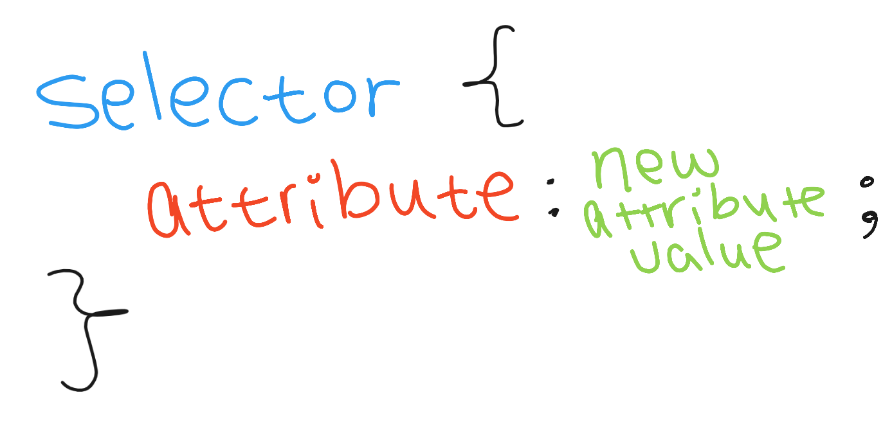
Part 2 Walkthrough: CSS How-to
Now to change actual parts of our website!
CSS targets HTML element through a ‘selector’ - for example if we write in ‘p’, then it’ll target / select all paragraph tags
Inside the curly braces, we can describe what should be changed about our target. For example, we can say that the [attribute] should now be “red”
For example:
color: “red”;
Will make the selected paragraph elements have a red text instead
Attributes have specific names - you may need to Google to find out whichever ones you need! (e.g. google ‘css font italics’ to find the attribute for it!)
# EXAMPLE

Slide 16

Exercise: Apply CSS!
Knowing everything just taught, change your website!
Make the following changes to your website:
Ensure at least one heading has red text
Change all paragraph tags to be in italics instead
Ensure that at least one heading is underlined too
You have up to 10 minutes for this (depending on your instructor's discretion + time!). Make sure to google the CSS attributes you need (e.g. how to underline text! Or how to change text color to be red!).
# REMINDER OF SYNTAX
# EXAMPLE
OUTPUT

Slide 17

Closing CSS Remarks
Stuff you should definitely research! It may come up on the homework as well!
CSS Selectors can be used to target elements - these elements can have CSS effects that we write applied to them for decoration
CSS Selectors can be combined together (e.g. multiple selectors in one line) or made incredibly specific (target only one paragraph tag nested inside an h1, with ID of xyz) - make sure to research this and read on!
We’ll continue more on CSS in the next lesson!
# FINAL EXAMPLE OUTPUT
(TO ACHIEVE IN NEXT LESSON!)

Slide 18
SUMMARY
HTML is used to build the skeleton and base body of the website - like the base DNA that determines how many ‘eyes, limbs, etc’ our bodies have.
Using HTML, we determine what elements the website has
CSS is used to decorate - like how DNA determines that x person’s eyes are ‘brown’, we can use CSS to change the visual aspects of our website
HTML and CSS are independent of each other - they’re (normally) separate files so that it's easier to write them. We usually link a HTML file to a respective CSS one.

Slide 19
THANK YOU!

